Slide 1
Can a neural Willmore surface be trusted?
Certificates and adversarial tests from the analysis of the Willmore functional
Nina da Hora, MSc, Institute of Computing (IC), Unicamp
MM845 AI for Geometry, mini-project. IMECC, Unicamp, October 2026
Lecturers: Henrique N. Sá Earp, Edward Hirst, Tomás S. R. Silva
Notes:
Quando esse paper foi apresentado aqui, a pergunta que ficou foi: como a gente sabe que esse número é verdade? O projeto responde a isso ao pé da letra.

Slide 2

Problem
The neural Willmore flow: method and unchecked properties
Hirst, Sá Earp, Silva. Minimising Willmore energy via neural flow, arXiv:2604.04321 (2026)
What the method does | What is never checked on its output
A tanh network phi(u, v) -> R^3 on spectral features; curvatures by automatic differentiation. | The topology (is the output still a torus?).
Loss: Monte Carlo estimate of int H^2 dA on 5000 uniform random points, with a Huber cap on H^2 at 50 and regularity terms; Adam. | The Willmore equation (is it a critical point?).
Recovers 4pi (sphere) and 2pi^2 (Clifford torus); reports W = 30.2 for genus 2. | Mobius invariance of the reported energy; embeddedness (no self-intersection term).
One run per genus, one seed, no error bar. | The estimator itself: is the reported number the energy of the surface?
The question of this project: can the analysis of the Willmore functional, made computable, certify a numerical surface, and where does the training signal fail?
arXiv:2604.04321
Notes:
Não é crítica; é a lista do que a análise do próprio paper permite calcular e ninguém calculou.

Slide 3
Methods
Certificates derived from the analysis of W
An identity with an exact reference value, computed on a grid the training never saw. A residual size is a diagnostic, reported with a band, not pass or fail.
No. | Theorem | Computed on the network output | Pass rule
1 | Gauss-Bonnet | int K dA on the frozen grid | |int K dA - 4pi(1 - g)| < 1e-3 x 2pi on a converged grid
2 | Mobius invariance | W after two inversions, centres outside and at the centroid | relative difference < 1e-3
3 | Li-Yau | certified W against 8pi; triangle mesh of the output tested for self-intersection | W < 8pi certifies embeddedness; a crossing with W < 8pi convicts the estimator; above 8pi only the mesh speaks
4 | Willmore equation | L2 norm of Delta H + 2H(H^2 - K): direct (4th derivatives) and variational (2nd derivatives) | relative: < 0.05 critical, < 0.5 near-critical, else not critical
5 | Energy quantisation | the attack: a grafted bubble phi + eps exp(-d^2/rho^2) n; reward = W_cert - W_Huber | an accepted surface with reward > 2pi
Course material used: Lectures 4, 12, 13 (the neural flow, PINNs, geometric flows), 2 (baselines, the flow's metric, optimisers), 3 (linear ansatz), 9 (search ladder as adversary), 7 and 8 (basin map). Lectures 5, 6, 10, 11 have interfaces written, not run.
Notes:
Só material das aulas. A última linha do slide diz de onde vem cada parte.

Slide 4
Methods
Reported energy and certified energy
 | Reported energy, W_rep (the training signal) | Certified energy, W_cert (the harness)
How | domain area x mean of H^2 sqrt(g) over 5000 uniform random points; Huber cap on H^2 above 50; one seed | int H^2 dA by spectral quadrature in float64 (midpoint rule in periodic directions, Gauss-Legendre toward the poles), grid refined until Gauss-Bonnet closes to 1e-6
Weakness | random samples miss small features; the cap hides large curvature; the value moves with the seed | needs a grid that resolves the surface; the resolution protocol guarantees it, with Gauss-Bonnet as the criterion
Check | none internal | an exact zero: Gauss-Bonnet on the same grid, 1e-15 on the checkpoints
Harness: certificates.py, any differentiable phi(u, v) -> R^3 in torch; same autodiff curvatures as the paper; nothing clamped (a NaN is a finding).
Validated twice before touching a network: numpy with finite differences and torch with autodiff agree to 1e-10 on the exact sphere, ellipsoid, Clifford torus and a torus of the wrong aspect ratio (18 tests, 4 s). The wrong torus passes Gauss-Bonnet and fails the Willmore equation: right topology is not Willmore (appendix).
The gap W_cert - W_rep is not a certificate. It measures how far the training signal can be pushed from the truth; the attack maximises it.
Notes:
Vão me perguntar: a sua quadratura também é um estimador. É, mas tem um zero exato pra se conferir. O Monte Carlo não tem conferência interna.

Slide 5
Data
Data and runs
Everything shown was run.
What | How many | Role
Exact surfaces: sphere, ellipsoid (1,1,2), Clifford torus, torus R = 3 | 4 | unit tests of the harness; the trivial baseline (Lecture 2)
Outputs of the published flow, trained with the released code and configs | genus 0 (30 epochs), genus 1 (200 epochs, best at 141) | the objects audited
Grafted bubbles on the trained torus | 16 (4 heights x 4 widths), 5 seeds each | the attack (certificate 5)
Training-estimator replicas | 5 seeds x n = 5000 per surface | bias, spread, Huber effect
Alternative methods under the same audit | linear spectral ansatz; published flow with 2 more seeds (the residual-loss PINN did not run) | the ingredient table
Perturbed initial tori through the published flow | 6 Fourier-perturbed, 2 twisted tau, 1 (2,3) torus knot | a first basin map
Evaluation grids: 48^2 to 384^2 tensor grids, never used in training. Genus 2 (the June reproduction, W_rep = 29.70 and 29.23) is not audited yet: the two-chart quadrature is not written.
Tooling. The harness code was drafted with an AI assistant (Claude) from my specification; the protocol text and slides were organised with its help. The certificates, thresholds, experimental decisions, all runs and the interpretation are mine. Numerical claims were cross-checked by two independent implementations (numpy and torch) agreeing to 1e-10 on exact surfaces; 18 unit tests pass.
Notes:
Tudo sintético, semeado, CPU. O gênero 2 fica fora porque a quadratura de duas cartas não existe ainda. Tooling: o código do harness foi escrito com um assistente de IA a partir da minha especificação, e ele ajudou a organizar o protocolo e os slides. Certificados, limiares, decisões, rodadas e interpretação são meus; cada número passou por duas implementações independentes.

Slide 6
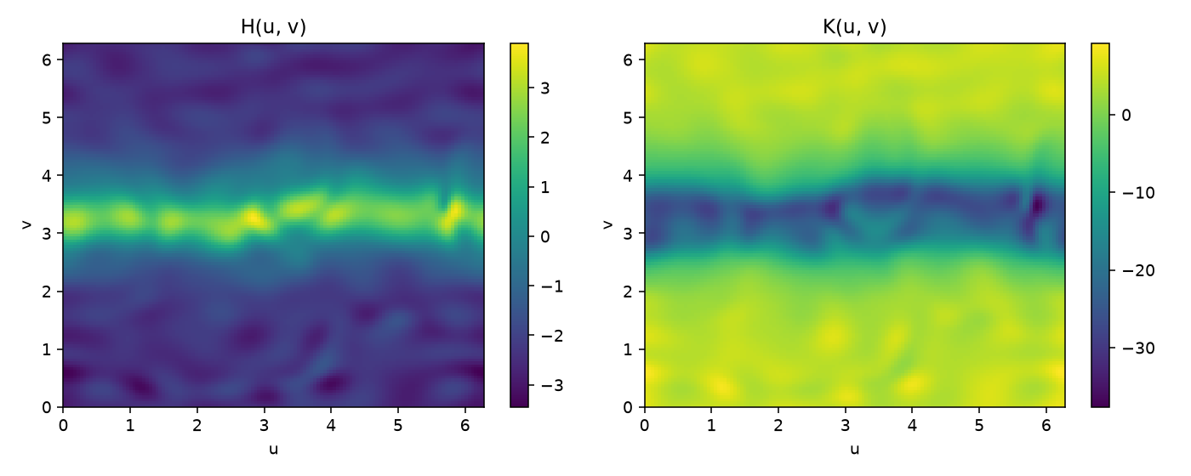
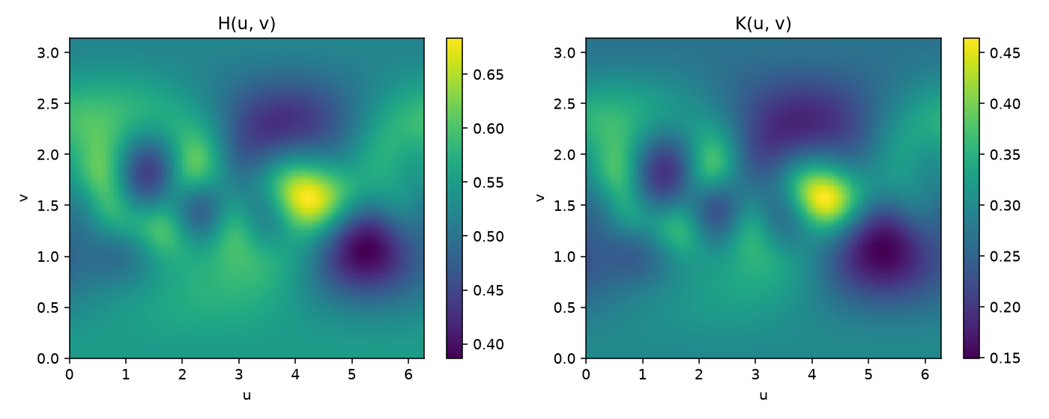
Results
Certificate 4: Willmore equation residual
r = Delta H + 2H(H^2 - K); bands: critical < 0.05 < near-critical < 0.5 < not critical
Checkpoint | W_cert / min | Direct | Variational
Torus, run_1 | 1.0117 | 0.99, not critical | 0.21, near-critical
Sphere, run_2 | 1.0025 | 0.94, not critical | 0.22, near-critical
Torus: 98.1% of H's spectral energy is below mode 6 (the network's Fourier range); the 1.9% above is the mottling in the map, amplitude 0.05. A ripple of amplitude a and frequency k costs a^2 in energy and a k^4 in Delta H: the energy is blind to it, the equation is not.
Sphere: smooth by construction (harmonics up to degree 2), simply not round. Near a minimum the energy is quadratic in the deviation (0.25% in W), the residual is linear (20%). The energy criterion is second-order blind where the equation sees first-order.
Variational measurement (second derivatives only): near-critical in the smooth directions, not critical in the fine ones.
H and K of the trained torus (top) and sphere (bottom), on the parameter grid
Notes:
Dois checkpoints, dois motivos diferentes pro mesmo veredito.

Slide 7
Results
The training estimator: spread, bias and epoch selection
5 seeds at n = 5000, the published setting. Bias is significant above 2 sd / sqrt 5. Two surfaces within 2 sd are a tie.
Surface (published flow, unchanged) | W_cert (x min) | W_rep, 5 seeds | Reported by the training | Reading
Torus, run_1, best-by-reported epoch (141 of 200) | 19.9710 (1.0117) | 19.906 +- 0.092 | 19.721 | 1.3% below certified; epoch 199 has W_cert 19.873 (1.0068): the selected surface is 0.5% worse
Sphere, run_2, last epoch | 12.5981 (1.0025) | 12.633 +- 0.068 | 12.735 | 1.1% above certified
Sphere, run_2, best epoch by reported energy | 12.6997 (1.0106) | 12.749 +- 0.090 | 12.424 = 0.9887 x 4pi | reported below the minimum; the selected surface is worse than the last epoch
Torus from a Clifford-shaped initial surface (6 runs) | 1.0014 to 1.0021 | spread 0.07 to 0.17 | 19.51 to 19.57, all below 2pi^2 | every best epoch is a draw below the proven minimum (Marques-Neves)
Torus, two more training seeds from the config's initial torus | 1.0070, 1.0084 | 0.15, 0.15 | 19.657 (below 2pi^2), 19.812 | seed spread of W_cert: 0.25%
The reported number is a draw around the certified one with a spread of about half a percent, in both directions. Selecting the best epoch selects the lucky draw: it reports values below proven minima, and on both the sphere and the torus it kept a worse surface than the last epochs.
Initial data matters more than the seed: from the config's thin torus the flow ends 0.7 to 1.2% above the minimum; from a Clifford-shaped start, 0.15 to 0.2%. The seed spread of the certified energy is 0.25%.
Consequence for genus 2: the train-sample energy oscillating between 28.9 and 30.6 on consecutive epochs is this noise; 30.19 (paper) and 29.70 (June reproduction) are a tie.
Notes:
Duas vezes o fluxo publicado, sem mudar nada, reportou um número que o teorema proíbe; e na esfera o critério de melhor época guardou a superfície pior. Não precisa de bolha.

Slide 8
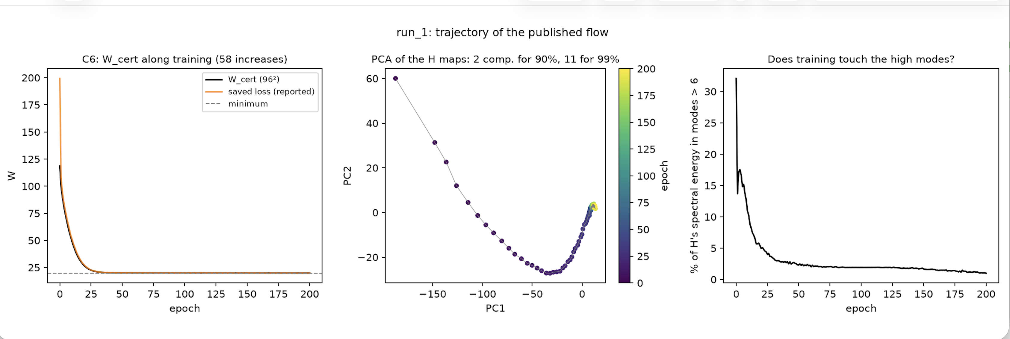
Results
Certificate 6 and the trajectory of one training run
run_1, 201 checkpoints (one per epoch), W_cert on 96x96 and the H map on 48x48 at each; PCA of the H maps (Lectures 7, 8)
C6 (Kuwert-Schatzle): the true Willmore flow is monotone; the certified energy of the training rises in 58 of 200 epochs. The optimiser descends on the estimator, and a quarter of its steps raise the energy. The best-by-reported checkpoint (epoch 141) is 0.5% worse than epoch 199.
The trajectory is two-dimensional: 2 principal components of the H maps carry 90% of the motion, 11 carry 99%, in a 33 859-parameter network. Training moves on a low-dimensional manifold.
High modes (above the feature band, k > 6): 32% of H's spectral energy at epoch 0, 2% by epoch 40, 1% at epoch 200. The mottling that fails certificate 4 is what the energy gradient removes last: a ripple of amplitude a costs a^2 in W, so the flow barely sees it.
Notes:
A aula 7 e 8 entram aqui: a trajetória do treino como curva no espaço de superfícies. Duas dimensões. E o C6 que estava marcado como um dia rodou em 24 segundos porque o fluxo salva um checkpoint por época.

Slide 9
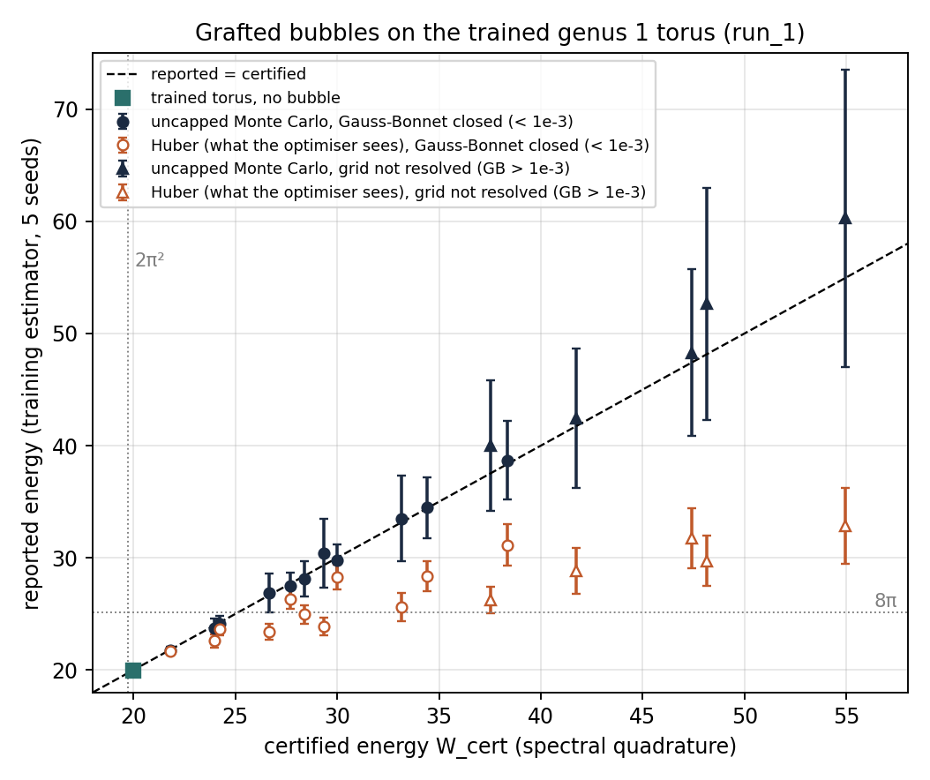
Results
Adversarial test: grafted bubbles on the trained torus
16 bubbles on the genus 1 checkpoint (W_cert = 19.971), 5 seeds each, grid refined per bubble
eps | rho | W_cert | GB residual | Uncapped MC | Huber (optimiser) | Hidden
0.05 | 0.5 | 21.81 | 4e-15 | 21.75 +- 0.34 | 21.66 +- 0.30 | 0.4%
0.05 | 0.3 | 23.95 | 5e-15 | 23.68 +- 0.88 | 22.59 +- 0.57 | 4.6%
0.05 | 0.15 | 29.32 | 8e-6 | 30.42 +- 3.06 | 23.86 +- 0.78 | 21.6%
0.10 | 0.2 | 33.14 | 5e-6 | 33.50 +- 3.81 | 25.59 +- 1.28 | 23.6%
0.30 | 0.3 | 38.35 | 7e-7 | 38.70 +- 3.51 | 31.14 +- 1.85 | 19.5%
The uncapped estimator is unbiased, but its seed spread grows from 0.3 to 13 as the bubble sharpens.
The Huber value is what the optimiser descends on: it hides up to a quarter of the energy and saturates near 25 to 33 whatever the true value.
Row 3: certified 29.3, above 8pi; reported to the optimiser 23.9, below 8pi. A bubble of height 0.05 moves the training signal across the Li-Yau line.
Gauss-Bonnet closes to 1e-6 on these rows: topology certified. Mesh test: the 29.3 bubble does not self-intersect (above 8pi, only the mesh can say so); the 0.3-high bubble crosses the opposite wall, and the training's regularity thresholds accept it.
Notes:
A bolha mostra o que o estimador não enxerga; se o fluxo entra nesse ponto cego sozinho é o experimento das bacias.

Slide 10
Analysis
Audit table and comparison criterion
One row per family of surfaces; value and verdict in every cell. 17 audited surfaces, 8 mesh-tested; full table in the repository.
Surface | Runs | W_cert (x min) | C1 Gauss-Bonnet | C2 Mobius | C3 Li-Yau | C4 residual
Published flow, sphere (last epoch / best-by-reported) | 2 | 1.0025 / 1.0106 | pass, 1e-14 | 1e-16 | embedded; mesh: no crossing | 0.94 / 0.99, not critical
Published flow, torus, config's initial torus (3 seeds) | 3 | 1.0070 to 1.0117 | pass, 4e-15 | 1e-16 to 2e-8 | embedded; mesh: no crossing | 0.95 to 0.99, not critical
Published flow, torus, Clifford-shaped initial surfaces (6 Fourier, 2 twisted) | 8 | 1.0014 to 1.0176 | pass, 5e-15 | 5e-15 to 3e-9 | embedded; mesh: no crossing (2 tested) | 0.75 to 0.95, not critical
Published flow, torus from a (2,3) torus knot tube | 1 | 1.8818 (above 8pi) | pass, 7e-15 | 5e-11 | W >= 8pi, theorem silent; mesh: crosses (784 pairs) | 0.99, not critical
Linear spectral ansatz, no hidden layer (Lecture 3) | 1 | 1.0033 | pass, 4e-15 | 7e-14 | embedded | 0.80, not critical
Residual-loss PINN, weak form (Lectures 12, 13) | 1 | 1.0620 | pass, 4e-15 | 2e-16 | embedded | 0.98, not critical
Every surface produced is a genuine closed surface of the right genus, Mobius-consistent; none is a critical point of W. 8 of 9 initial data reach the Clifford basin. The ninth started as an embedded knotted tube and the flow unknotted it by passing through itself: an immersed torus at 1.88 x, accepted by the training (no self-intersection term, thresholds pass), seen only by the mesh. Depth is worth about 0.15% on genus 1; the initial surface, ten times that. The residual-loss arm zeroes the first variation where it looks and still fails the direct residual: 6% above the minimum.
Better, within a declared boundary (genus, initial data, budget): at least as good on every axis and strictly better on one. Otherwise a trade-off, and the table says which. In geometry a result holds under its hypotheses; here they are the first column.
Notes:
Em geometria, melhor é um teorema com hipóteses enunciadas; em computação é dominância dentro de uma fronteira. A auditoria faz o segundo parecer o primeiro. Linhas entre colchetes: o que terminou entra, o que não terminou eu digo.

Slide 11



Summary
A finer grid gives a better number; a certificate gives a reason to believe it, and in one case (Li-Yau) it can show that the estimator is wrong.
Found | Not claimed
Gauss-Bonnet fails before W converges: it is the resolution criterion. All 17 audited outputs are closed surfaces of the right genus and Mobius-consistent; none is a critical point of W. The reported energy is a draw around the certified one (half a percent); best-epoch selection picks the lucky draw, reports values below proven minima, and on the sphere kept a worse surface. The certified energy rises in a quarter of the training steps (C6) and the trajectory is two-dimensional. Initial data matters ten times more than the seed. From a knotted start the flow crosses itself and stalls immersed at 1.88 x; nothing in the training notices, the mesh does. A bubble of height 0.05 hides 22% of the energy from the optimiser. | Anything about the genus 2 minimiser; optimality of any method in general; that a passing certificate proves the surface is the minimiser. A pass means: consistent with a Willmore surface of that genus at that resolution. Next steps and their cost: previous slide.
Code, protocol, results and these slides: github.com/NinadHora/MM845 (willmore-audit/). The protocol document fixes every threshold and its justification.
Paper: arXiv:2604.04321
WillmorePINN code
MM845 course material
This project: github.com/NinadHora/MM845
Notes:
Fecha na frase e para.

Slide 12
Results
Appendix: validation on exact surfaces; grid resolution
Surface | W obtained (expected) | int K dA (expected) | Willmore residual
Sphere | 12.5663706143 (4pi) | 12.5663706143 (4pi) | 7.6e-7, critical
Clifford torus | 19.7392088023 (2pi^2) | 4.6e-11 (0) | 1.6e-6, critical
Torus R = 3 | 31.4048888987 (closed form) | 2.7e-10 (0) | 0.81, not critical: a valid torus that is not a Willmore torus
Grid resolution. On a surface with a thin feature, Gauss-Bonnet fails visibly on a coarse grid while W is still moving by tens of units; its reference value is exact and W's is not. So the harness refines every grid until Gauss-Bonnet closes to 1e-6, and reports the grid with each certificate.
On the two checkpoints: chi-hat = 2.000000 and 0.000000 (residuals 1e-14, 1e-15); Mobius with two centres: 1e-16; both below 8pi, so embedded by Li-Yau.
Notes:
A quarta linha é importante: topologia certa não é Willmore. E Gauss-Bonnet virou o critério de convergência da numérica inteira.

Slide 13
Analysis
Appendix: limitations, and what was left out
Estimates are working days on a laptop CPU unless the cluster is named. The plan allowed stopping before every item below.
Item | Status and limitation | Estimate
Genus 2 | not certified: the two-chart quadrature (disc removed from each chart, collar counted once) is not written; everything said about genus 2 is at the level of the reported energy | 1 to 2 days
Basin map | 9 initial data instead of 30 to 50; with 9 points the clustering says little, so Figure 2 is not shown | 1 night on the cluster (slurm/basins.sbatch) + half a day
Attack ladder | rung 1 only (random search over bubbles); no bubble passes the strict acceptance rule (loss within 2 sd of the base), so no formal success; greedy is written, not run; annealing over the weights not written | greedy half a day; annealing 1 to 2 days
Published flow | used as released, not reimplemented (deliberate: the audit must be independent of the training loop, and a reimplementation adds no certificate) | not planned
C4 on a network | fourth derivatives of a tanh network are noisy; the threshold is a band, not a line; the variational fallback only sees smooth directions | inherent
Residual-loss PINN | weak form only (18 test directions); the pointwise form does not run in this torch build; diverged at lr 1e-3, stable at 1e-4 with clipping | pointwise form via jacrev: 1 day
Mesh test | 96 x 96 grid; detects a 2% overlap, clean at a 5% gap; a near-touch below the grid scale is missed | finer grids: hours
C6 Kuwert-Schatzle | ran on one run only (run_1: 58 increases in 200 epochs); the other 16 runs have per-epoch checkpoints and take 30 seconds each | hours
C7 Weiner, Hessian index | not run: Hessian-vector products, Lanczos, Mobius and reparametrisation modes projected out; the gauge projection is the hard part | 3 to 5 days
C8 Bobenko discrete energy | not run: the mesh now exists, the formula is short | half a day
Other arms | L-BFGS and Sobolev flows (half a day each); periodic CNN, set transformer, mesh flow (2 to 3 days each) | see left
Notes:
Tudo que está aqui o plano já permitia cortar. A ordem de retomada: malha já existe, então Bobenko primeiro; depois gênero 2; depois bacias no cluster; Hessiana por último.

